Slide 1



PROJECT PRESENTATION (BCS 554)
MARCH 01
Public Printer
An automated system that lets users scan a QR code, upload documents, pay, and print instantly without human
assistance
PRESENTED TO
PRESENTED BY
KIET Group of Institution
Presented by VANSH, SHARANDEEP, SHIV, YADUVENDRA

Slide 2
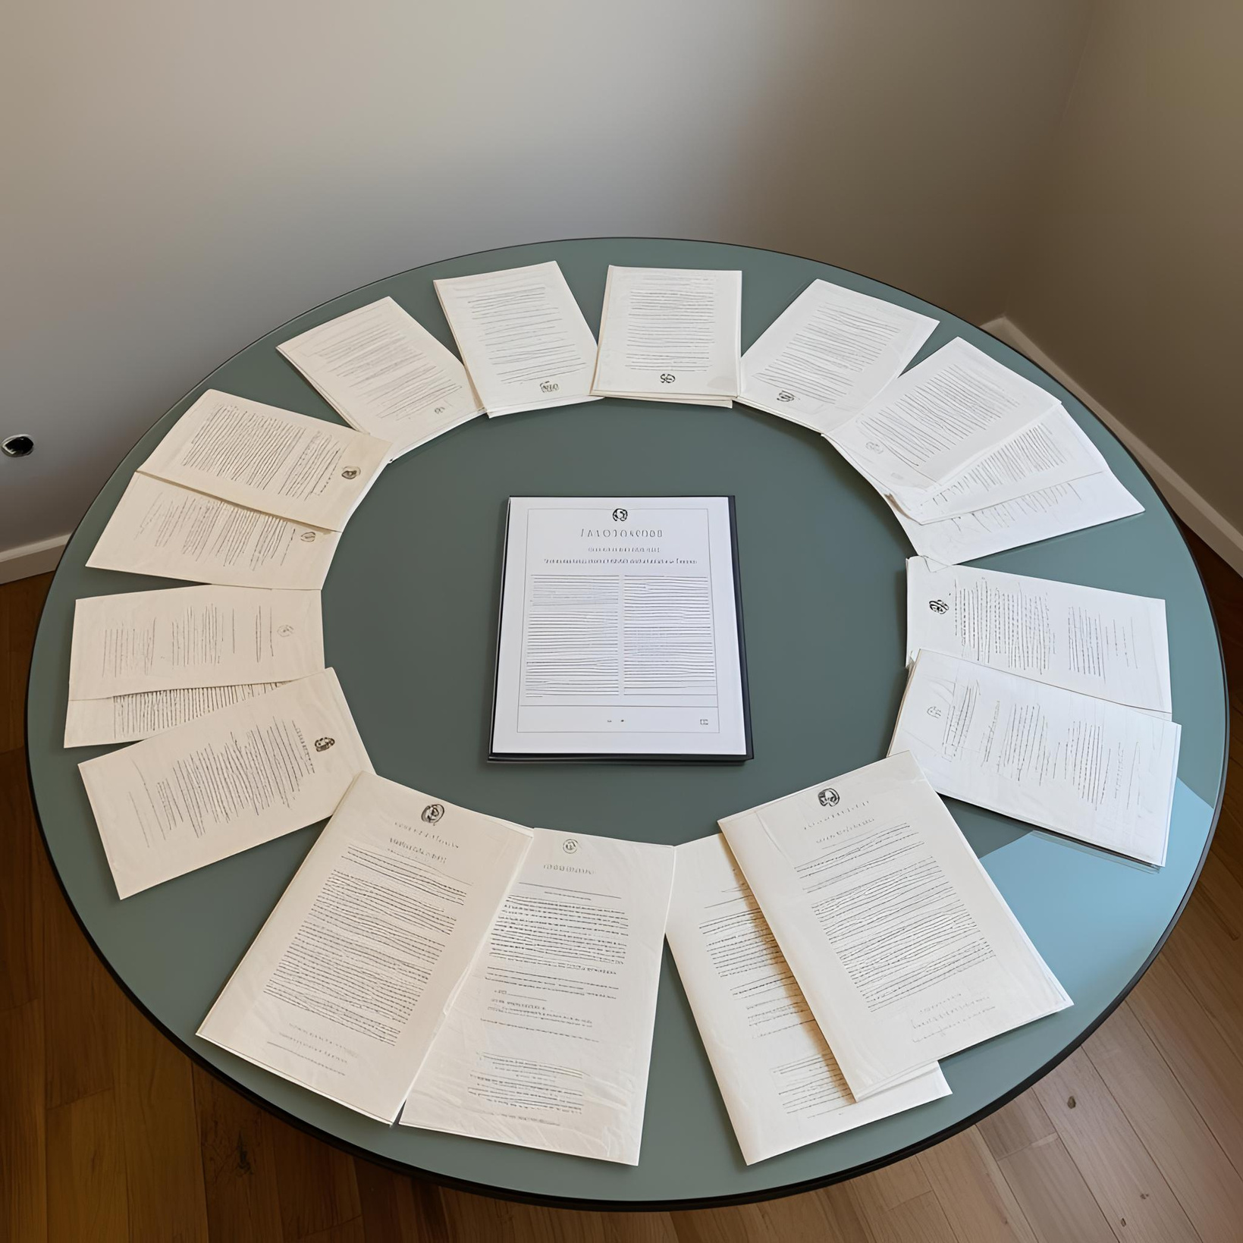


Table of content
Problem Statement
Objectives
Technology Used
Literature Survey
Proposed Methodology
References

Slide 3


Problem Statement
Define the issue your project addresses and its significance
Public and shared printing services rely heavily on manual processes, leading to inefficiencies, long wait times, and user inconvenience. Tasks such as document handling, payment processing, and print setup often require human involvement, which slows down the process, especially during peak hours.
Users face delays and frustration due to complex, outdated systems, while service providers experience higher operational costs from staffing and maintenance. Errors like incorrect print jobs further reduce user satisfaction.
To address these challenges, there is a growing need for an automated solution that enables users to scan, upload, pay, and print documentsinstantly, without human assistance

Slide 4
Objectives
List specific, measurable goals for your project
Automate the Printing Process:
Eliminate the need for human intervention by developing a fully automated system that allows users to scan, upload, pay, and print
documents seamlessly
Enhance User Convenience
Provide a user-friendly interface that simplifies printing, reduces wait times, and allows instant access to print services without queues or staff assistance
Increase Efficiency and Productivity
Streamline operations for service providers by reducing manual processes, minimizing errors, and optimizing resource management,
leading to lower operational costs and improved service delivery
Enable Self-Service Solutions
Implement a self-service model where users can handle all printing tasks independently, improving overall user experience and satisfaction
Ensure Scalable and Reliable Operations
Design the system to handle high demand and peak times without sacrificing performance, ensuring consistent, reliable service in
various environments such as offices, libraries, and public spaces.

Slide 5
Technology Used
Mention tools and technologies, explaining their selection
Frontend Technologies
DataBase Management
Backend Technologies
JavaScript Frameworks(React): For building interactive user interfaces.
QR Code Libraries(qr.js): For generating QR codes.
Vite:For building interactive user interfaces
MongoDB
MySQL
Node.js: For building the server-side application, handling requests, and connecting to databases.
Express.js: A web application framework for Node.js to create RESTful APIs

Slide 6
Literature Survey
Summarize key research findings and gaps your project fills
Secure QR Code-Based Document Management System for Public Printing Services
J. P. Singh, K. S. Varma, and P. M. Verma on May 2023
• This paper presents a system aimed at streamlining public printing services by using secure QR codes. The system allows users to upload documents and process payments remotely, making the public printing process faster and more secure. One of the key elements is the use of encrypted QR codes for authentication and document verification. These codes can be scanned and verified using offline devices, adding an extra security layer.
• The proposed system enhances privacy by using cryptographic methods and hardware security modules to create secure QR codes. It is also scalable and cost-efficient, making it applicable for large-scale use in public and commercial sectors.Additionally, the system can be integrated with biometric data for enhanced authentication, which could be useful for high-security environments like immigration, educational institutions, or government agencies.
• The paper explores the application of this secure QR code technology in various industries, including healthcare, education, and transportation.
• This solution is seen as a more secure and efficient alternative to current systems, offering flexibility and ease of use while maintaining data security.

Slide 7
Literature Survey
Summarize key research findings and gaps your project fills
Automated Public Printing Service Through QR Code-Based Payment and Document Uploades
B. N. Naga Vamsi, V. S. Srinivas, A. S. R. Murthy
• Sep 2023
• This paper discusses the development of an automated public printing system designed to allow users to print documents
without human intervention. The system relies on QR code-based payment and document upload to streamline the process.
The proposed solution addresses the need for a seamless, user-friendly public printing service that reduces the dependency
on staff while offering convenience and efficiency.
• User Flow:
•Users scan a QR code at the kiosk.
•They upload documents through a web interface.
•Payment is processed via a mobile wallet or online banking.
•Once payment is confirmed, the document is printed automatically.

Slide 8
Literature Survey
Summarize key research findings and gaps your project fills
QR code-based automated self-service kiosk for public printing and payment processing
G. Kulkarni, R. Bhatia, S. M. Mehta
• May 2022
• This paper discusses the development of a self-service kiosk that utilizes QR code technology for both printing and payment
processing. It highlights the kiosk's efficiency in improving customer experience by reducing wait times and the need for
human assistance. The paper also explores various design considerations and technological challenges faced during
implementa on

Slide 9
Literature Survey
Summarize key research findings and gaps your project fills
Development of an IoT-Based QR Code Access Control and Payment System using Arduino and ESP8266
G. Tejaswai, Chiruvella Manasa, Avadhanam Sandhya Sri, Amari Sravani, Challagundla Thanusree, Kandagaddla Lakshmi Akhila
• 2024
• This paper discusses the development of an IoT-based system that integrates QR code technology for access control and
payment processing. Utilizing Arduino and an ESP8266 Wi-Fi module, the system improves security and streamlines
transactions in various applications, such as parking and public transport. The study outlines the functionality of the system,
which verifies QR codes, deducts payment, and controls access based on user authen ca on

Slide 10
Literature Survey
Summarize key research findings and gaps your project fills
A QR Code-Based Self-Service Kiosk for Public Printing and Payment Processing
G. Kulkarni, R. Bhatia, S. M. Mehta
• 2022
• This paper presents a design for a self-service kiosk that uses QR codes for document printing and payment processing. It
discusses the technical specifications and user interface design, as well as the advantages of utilizing QR codes in public
printing services, such as convenience and efficiency

Slide 11
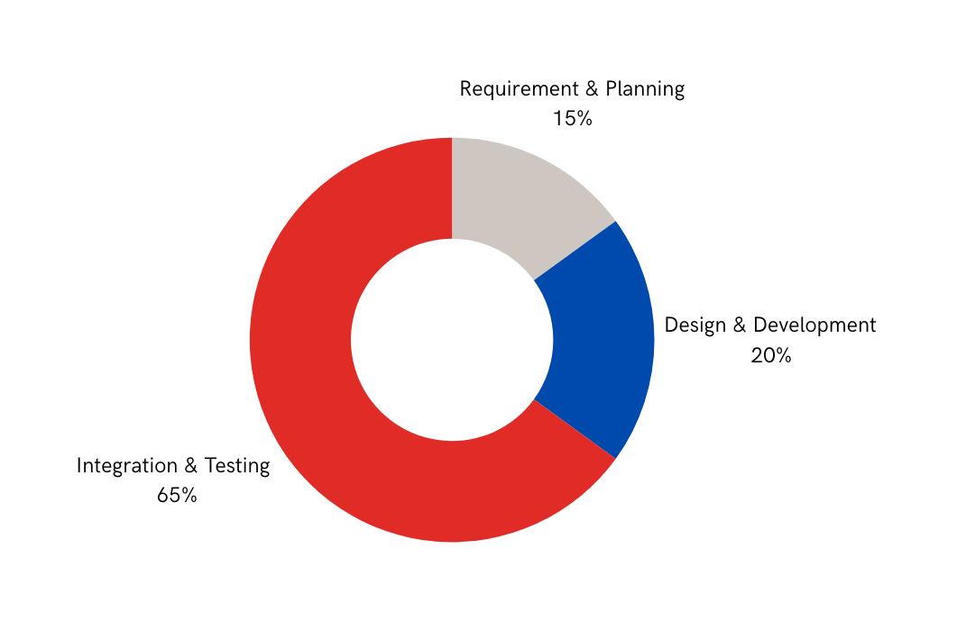
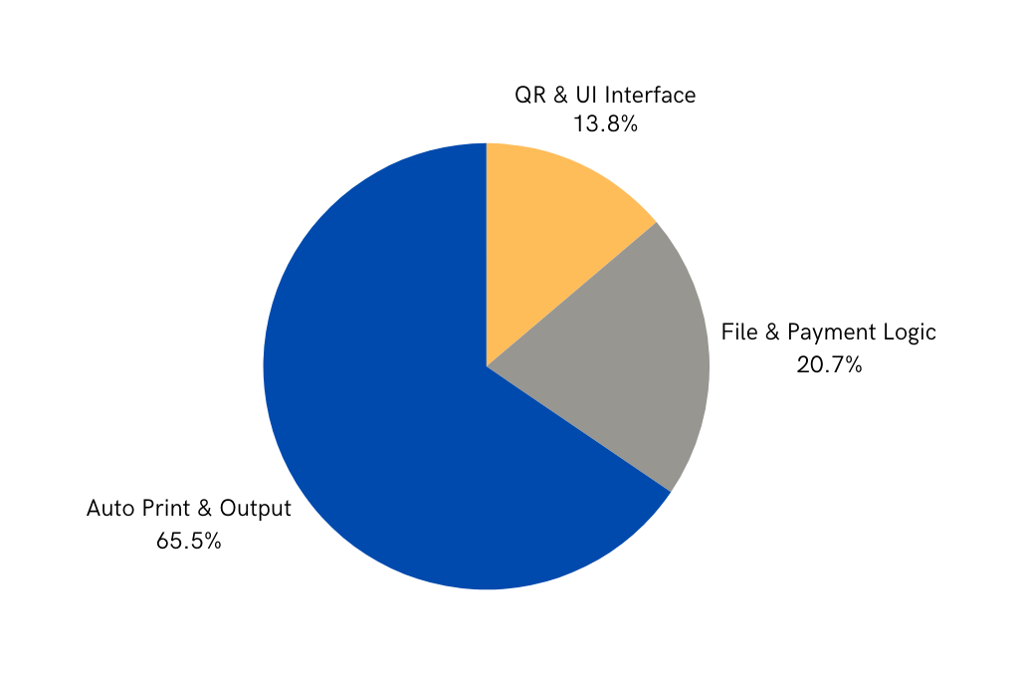
Overview of Methodology Steps
Analysis of Results
Phases of System Development
Distribution of Key Features

Slide 12
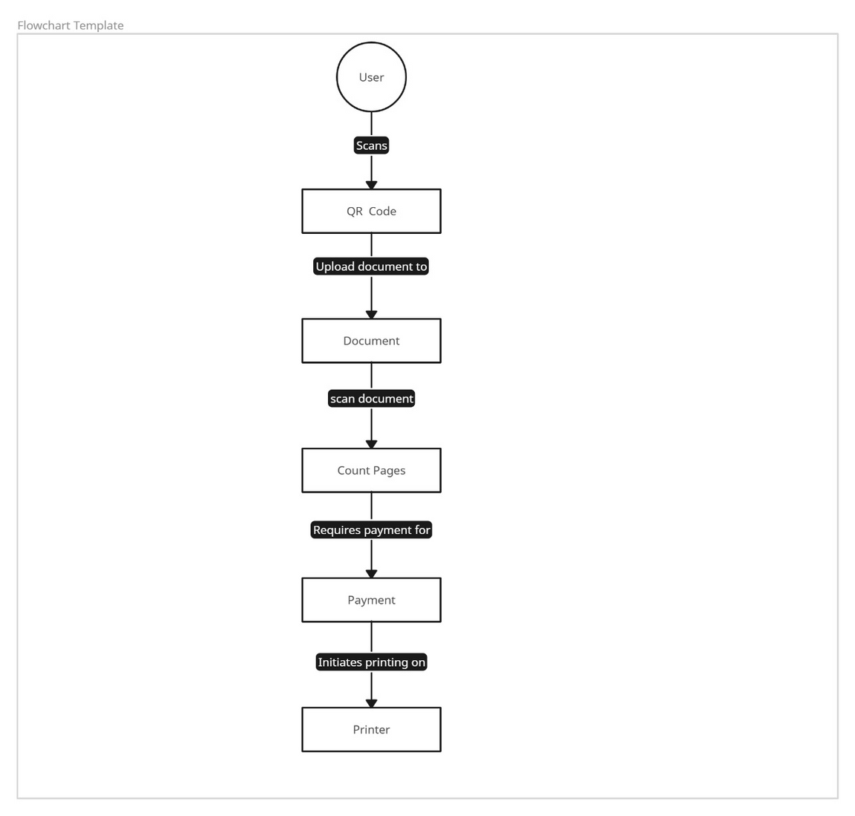

Slide 13


References
B. N. Naga Vamsi, V. S. Srinivas, and A. S. R. Murthy, “Automated
public printing service through QR code-based payment and
document upload,” International Conference on IoT and Applications,
pp. 67-72, 2023
G. Kulkarni, R. Bhatia, and S. M. Mehta, “QR code-based automated
self-service kiosk for public printing and payment processing,” IEEE
Transactions on Consumer Electronics, vol. 67, no. 3, pp. 1015-1022,
Sep. 2022
H. Lu, H. Wang, S. W. Yoon, and D. Won, “Real-Time Stencil Printing
Optimization Using a Hybrid Multi-Layer Online Sequential Extreme
Learning and Evolutionary Search Approach,” IEEE Transactions on
Components, Packaging and Manufacturing Technology, vol. 9, no. 12,
2019

Slide 14

THANK YOU FOR YOUR ATTENTION!
Thank you
Email
vansh.2226cs1056@kiet.edu
Call us
+91-9368008551
Github repo.
https://github.com/vansh1056/Major_project-Scan-pay-

